Slide 1
Mask R-CNN
& its ancestors

Slide 2
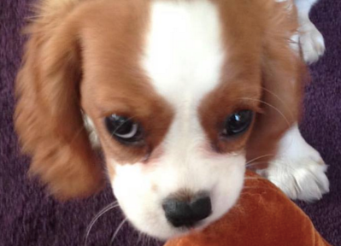

Classification vs Object detection & segmentation
Image level classification
Object detection & segmentation

Slide 3
R-CNN
Paper by Ross Girshick et al.
Focus on problems :
Localize objects with a deep network.
Training high capacity model with a small quantity of annotated data.

Slide 4
Problem 1
Approaches
Sliding window detector.
Recognition using regions:
At test time:-
2k category independent region proposals for the input image.
Fixed length feature vector from each proposal using CNN. (Image warping used)
Classify each region with category specific SVMs.

Slide 5
Modules
Problem 2
Approaches:
1. Unsupervised pre training followed by supervised fine tuning.
2. Supervised per-training on a auxiliary dataset (ILSVRC) →
Domain specific fine tuning on small dataset (PASCAL).
Region Proposals
Feature extraction

Slide 6
Modules
Region proposals
Input image dimensions : RGB 227x227
Use selective search’s “fast mode” to generate ~2000 region proposals.
No restriction on the method to generate region proposals.
Feature extraction:
4096 dimensional vector from each proposal using Caffe implementations of CNN.
Input image → 5 conv → 2 fully connected layers.

Slide 7
Test time detection
Selective search extracts ~2k proposals
Warp each proposal → f-prop using CNN → features
For each class → Score extracted feature vector using SVM → Greedy non maximum suppression for each class independently.
Training
Supervised pre-training.
Domain specific fine tuning
Simple linear regression on the region proposal to generate tighter bounding box co-ordinates

Slide 8
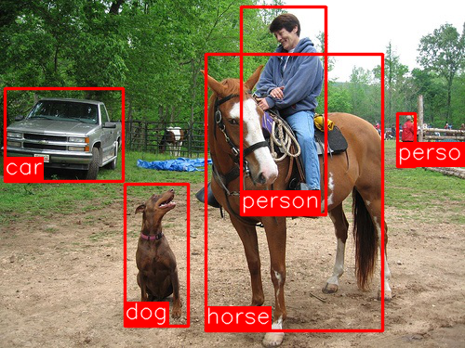
R-CNN takes in an image and identifies the locations and classifications of the main objects in the image.

Slide 9
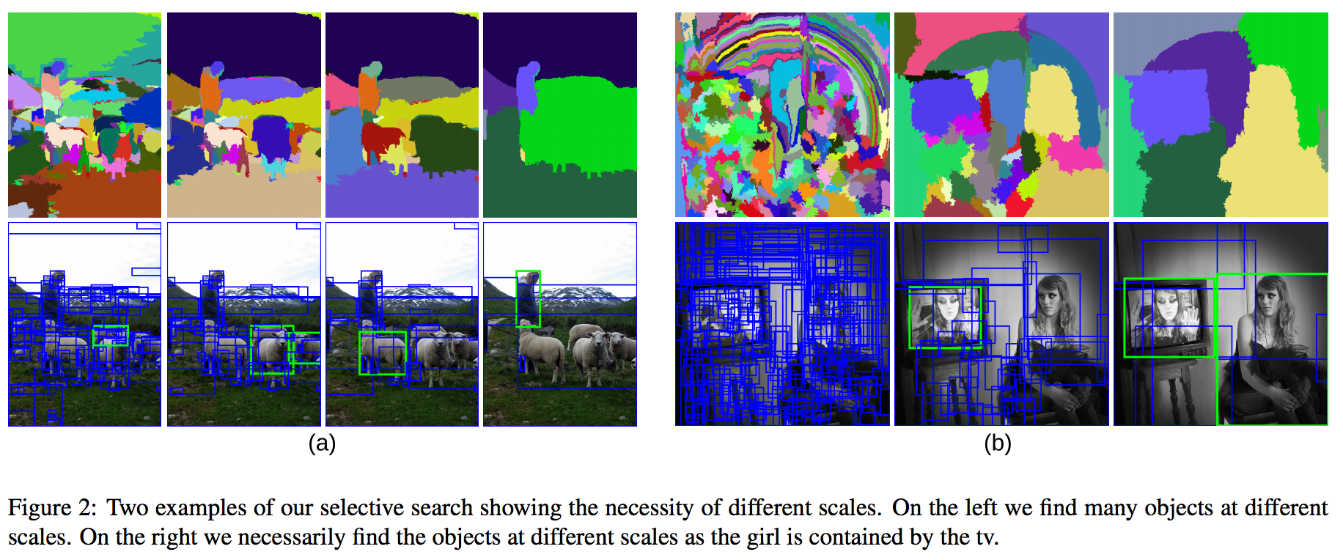
Selective Search looks through windows of multiple scales and looks for adjacent pixels that share textures, colors, or intensities

Slide 10
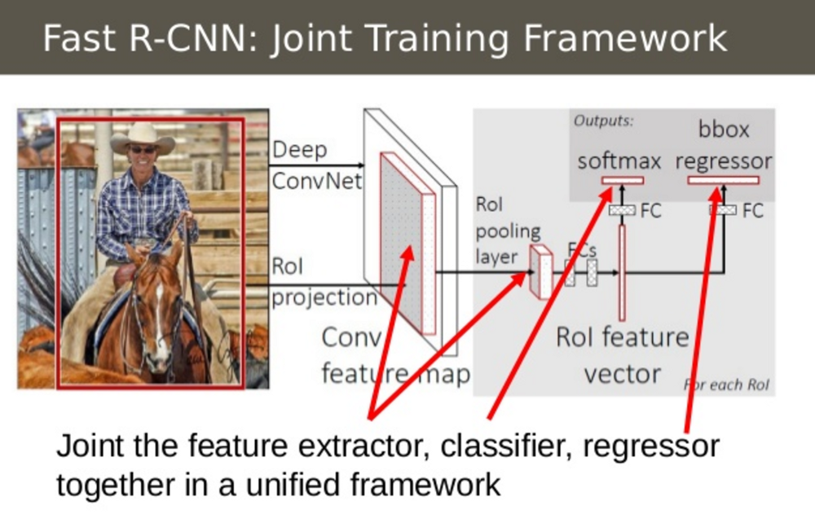
Fast RCNNs
Softmax probability :
K object classes + 1 background class
BB regressor :
*K co-ordinates i.e.
4 co-ordinates for each of the K classes

Slide 11
Initialize from pre-trained networks
RoI pooling layer
Each RoI in a feature map represented by : (r, c, h, w)
Grid of sub windows : (H x W) i.e. sub-window : (h/H x w/W )
Pooling applied → Each feature map channel.
Pre-trained ImageNet networks : 5 max pooling layers + 5-13 conv layers
3 transformations while initializing.

Slide 12
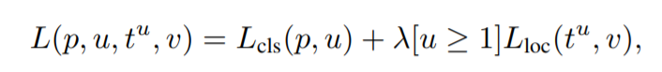
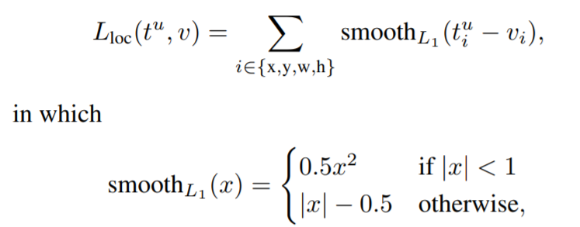
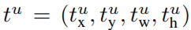
Multi-task Loss
L_{loc}, is defined over a tuple of true bounding-box regression targets for class u, v = (v_{x}, v_{y}, v_{w}, v_{h})
Predicted tuple →
The hyper-parameter λ in Eq. 1 controls the balance between the two task losses. It is taken to be 1

Slide 13
Faster R-CNN
Motivation :
One remaining bottleneck in the Fast R-CNN process → the region proposer.
Selective Search, a fairly slow process that was found to be the bottleneck of the overall process.
Change :
Region proposal network (RPN) to extract region proposals

Slide 14
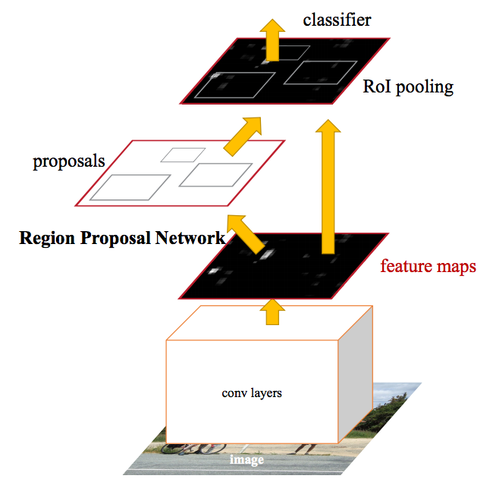

Slide 15
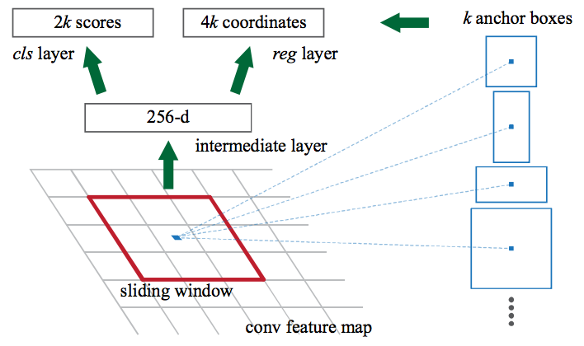
Region proposal network
Input : Image of any size
Output : Set of rectangular object proposals, each with an “objectness” score

Slide 16
R-FCN Paper by Jifeng Dai et al.
Motivation
Increase speed by maximizing shared computation.
Approach
Fully convolutional (shared) architecture.
Translational invariance is learned.
However, we also need translational variance. Why?
- Image classification → translational invariance preferred
- → translational variance

Slide 17
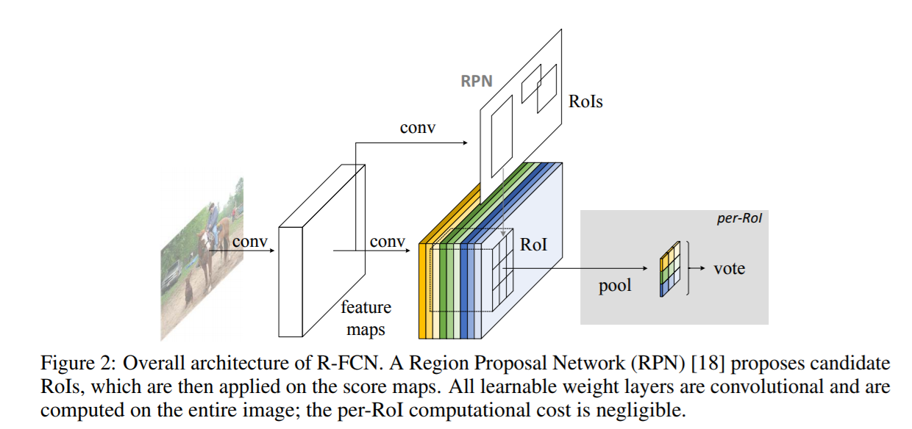
Overall architecture

Slide 18
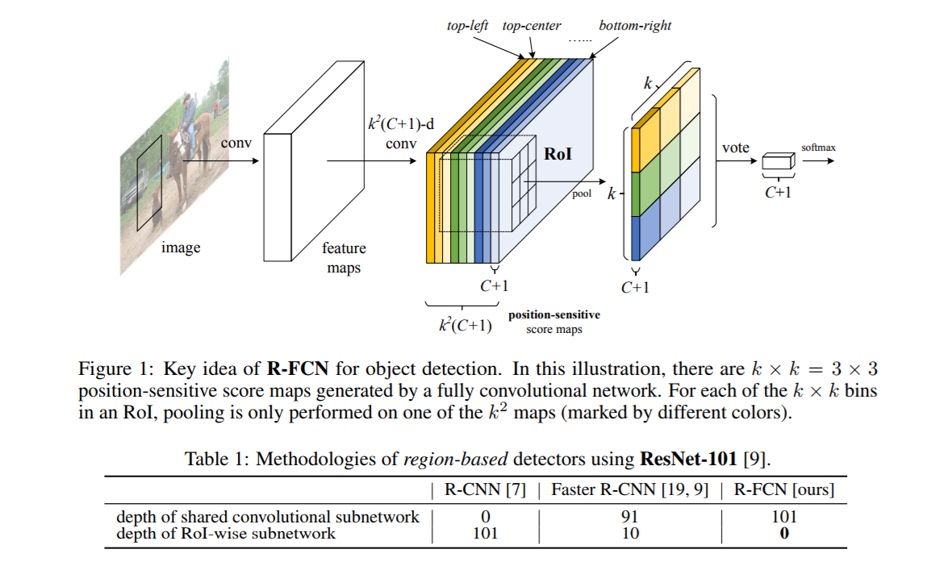
Translational variance
Position sensitive score maps

Slide 19
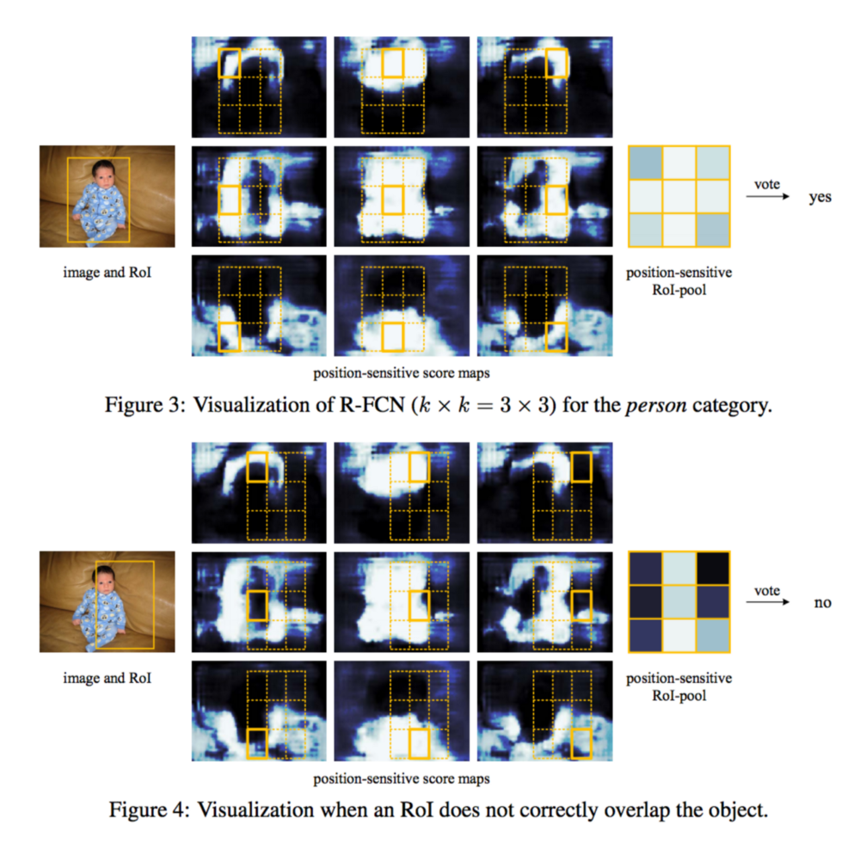
Visualization of Selective RoI Pooling
With end-to-end training, this RoI layer shepherds the last
convolutional layer to learn specialized position-sensitive score maps.

Slide 20
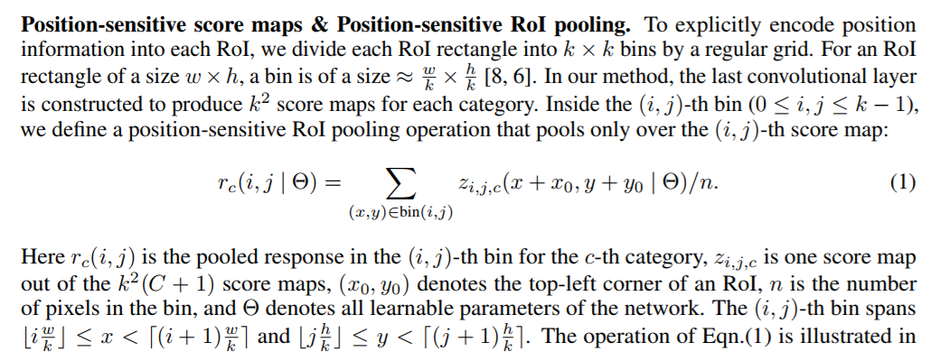
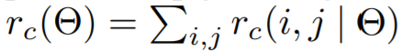
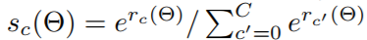
Position-sensitive score maps & Position-sensitive RoI pooling.
Figure 1, where a color represents a pair of (i, j).
Voting →
Softmax →

Slide 21
Similarly, for bounding box (BB) regression
Along with the k²(C +1)-d convolutional layer for objectness, we append a sibling 4k²-d convolutional layer.
The position-sensitive RoI pooling is performed on this bank of 4k² maps, producing:
4k²-d vector for each RoI → average voting → 4d vector
We perform class agnostic BB regression for simplicity, but the class-specific counterpart is applicable too (i.e. 4k²C-d output layer)

Slide 22
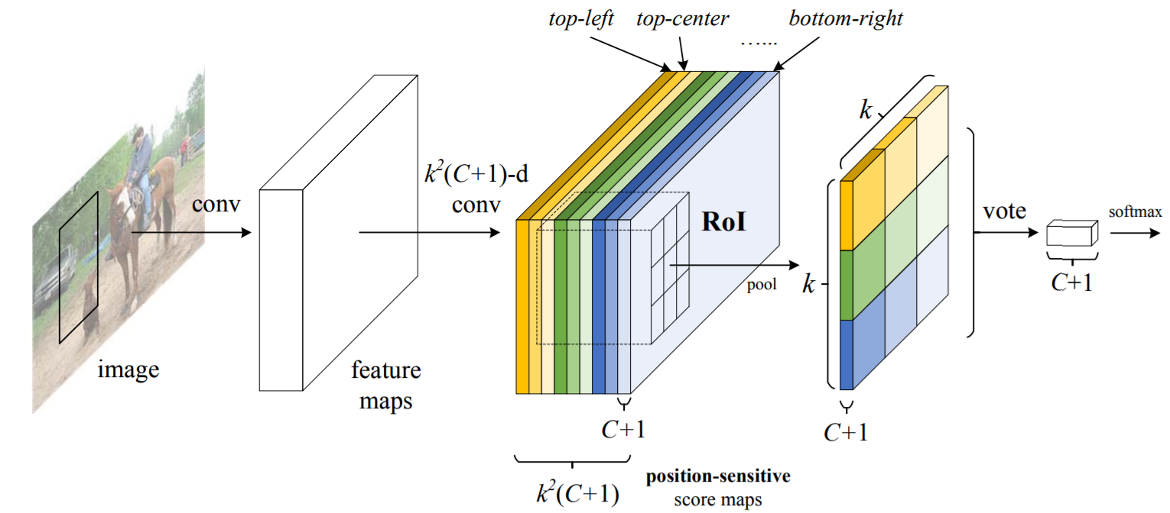
Similarly, for bounding box regression: *
4k²-d
regression
4-d
This 4-d vector parameterizes a bounding box as t = (t_{x} t_{y} t_{w} t_{h})
4
4
4k²-d

Slide 23
Loss function
Loss function defined on each RoI
L(s, t_{x,y,w,h}) = L_{cls}(s_{c∗} ) + λ[c∗ > 0] L_{reg}(t, t∗)
where,
c* = RoI’s ground-truth label, t* = ground truth box
L_{cls}(s_{c∗} ) = -log(s_{c∗}) : cross entropy loss
L_{reg =} Bounding box regression loss
λ = Balance weight = 1
Positive examples are the RoIs that have IoU overlap with a ground-truth box of at least 0.5, and negative otherwise

Slide 24
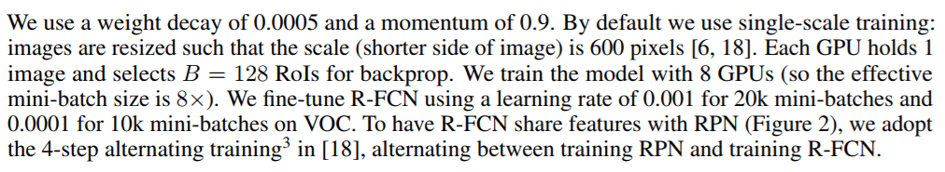
Training
[6] R. Girshick. Fast R-CNN. In ICCV, 2015
[18] S. Ren, K. He, R. Girshick, and J. Sun. Faster R-CNN: Towards real-time object detection with region proposal networks. In NIPS, 2015.

Slide 25
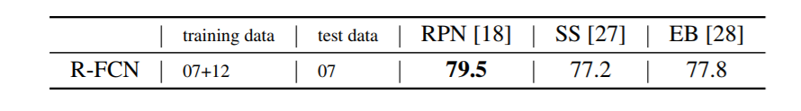
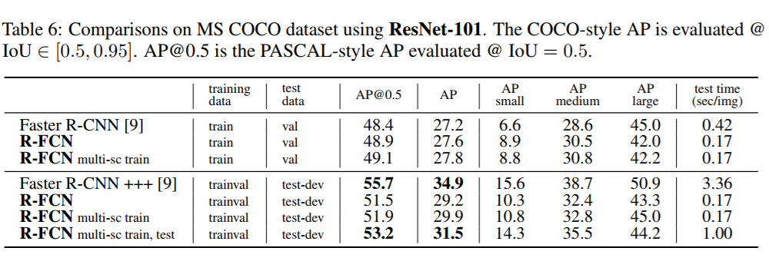
Results
Average Precision (AP)
Experiments on MS COCO dataset
On the Impact of Region Proposals
We evaluate on the MS COCO dataset that has 80 object categories.
Train set: 80k, Validation set: 40k, Test-dev set: 20k.
Learning rate = 0.001 : 90k iterations & next 0.0001 : 30k iterations, Effective mini-batch size = 8.
Extend the alternating training from 4-step to 5-step (i.e., stopping after one more RPN training step), which slightly improves accuracy on this dataset when the features are shared; we also report that 2-step training is sufficient to achieve comparably good accuracy but the features are not shared.

Slide 26
Mask RCNN by Kaiming He et al.
Mask R-CNN adopts the same two-stage procedure, with an identical first stage (which is RPN).
In the second stage, in parallel to predicting the class and box offset, Mask R-CNN also outputs a binary mask for each RoI.
Training:
Multi-task loss → each sampled RoI as :
L = Lcls + Lbox + Lmask.
Lcls = classification loss; Lbox = bounding-box loss;
Lmask = average binary cross-entropy loss
The definition of Lmask allows the network to generate masks for every class without competition among classes.

Slide 27
Attempts for instance segmentation
Based on segment proposals
Methods resorted to bottom up segmentation
DeepMask : Propose segment candidates → Classify them (Fast R-CNN)
Dai et al. : A complex multiple-stage cascade → predicts segment proposals from bounding-box proposals → classification
Li et al. :
Segment proposal system : Instance-sensitive fully convolutional networks + Object detection system : R-FCN = “fully convolutional instance segmentation” (FCIS).
Mask R-CNN is based on an instance-first strategy

Slide 28
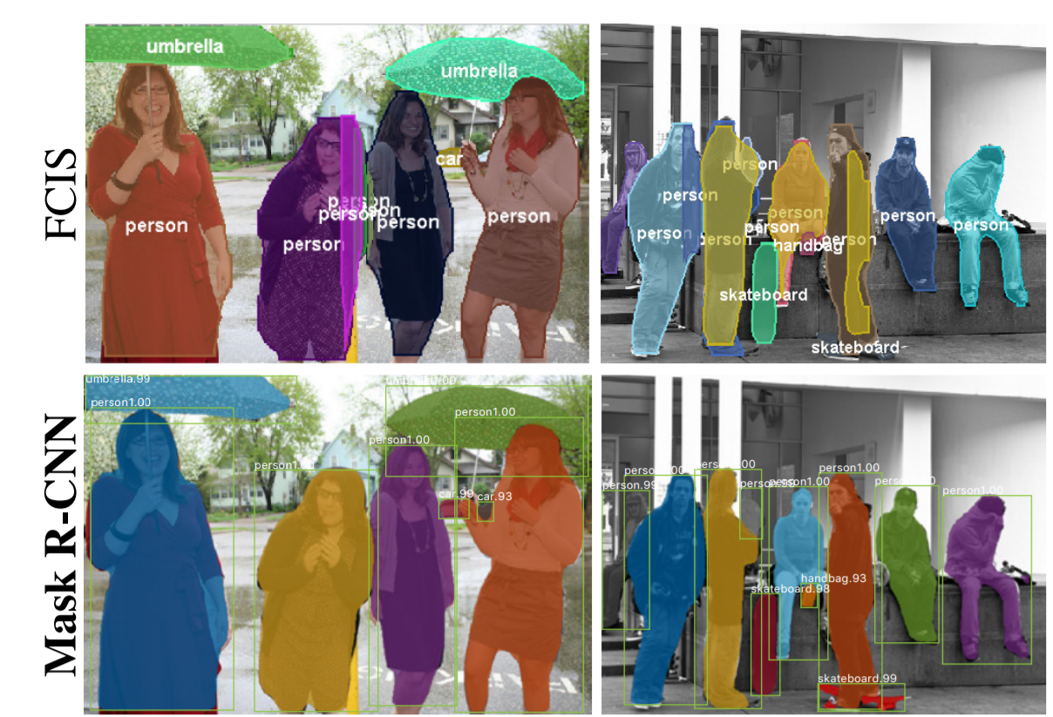
Attempts for instance segmentation
FCIS vs Mask R-CNN

Slide 29
Mask Representation
The mask encodes an input object’s spatial layout.
We predict an m × m mask from each RoI using an FCN. This allows each layer in the mask branch to maintain the explicit m × m object spatial layout without collapsing it into a vector representation that lacks spatial dimensions.
The pixel-to-pixel behavior requires RoI features, which are small feature maps, to be well aligned.
Hence, RoI Align has been introduced.

Slide 30
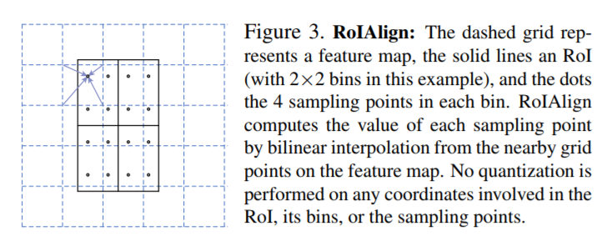
RoIAlign
Motivation
Regions of the feature map selected by RoIPool were slightly misaligned from the regions of the original image. Since image segmentation requires pixel level specificity, unlike bounding boxes, this led to inaccuracies.
RoIAlign improves mask accuracy by relative 10% to 50%, showing
bigger gains under stricter localization metrics

Slide 31
RoI Align
RoIPool quantizes a float RoI to the discrete granularity of the feature map → quantized RoI → subdivided into spatial bins which are themselves quantized → feature values covered by each bin are aggregated (usually by max pooling).
These quantizations introduce misalignments between the RoI and the extracted features.
In RoIAlign, rounding is avoided. We use bilinear interpolation to get a precise idea of what would be at pixel p (float). This, at a high level, is what allows us to avoid the misalignments caused by RoIPool.

Slide 32
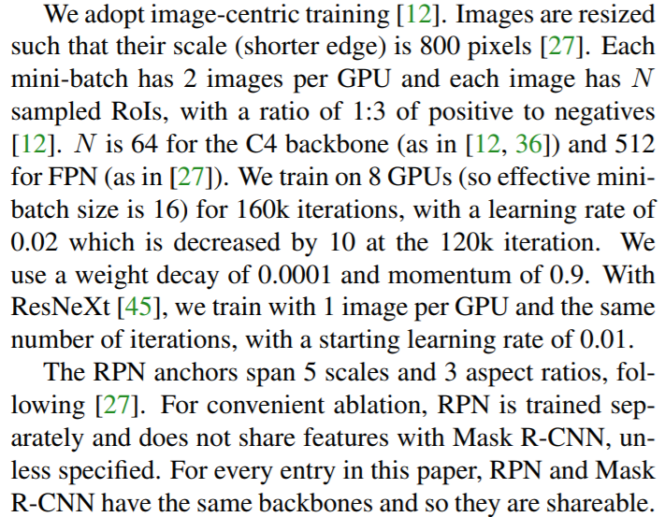
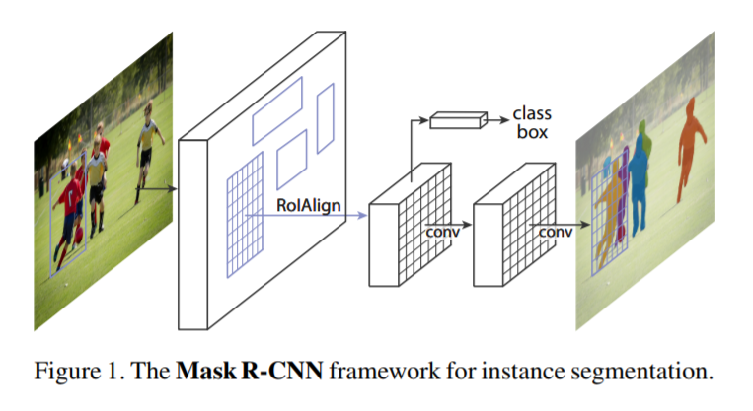
Training
[12] R. Girshick. Fast R-CNN. In ICCV, 2015
[27] T.-Y. Lin, P. Dollar, R. Girshick, K. He, B. Hariharan, and ´ S. Belongie. Feature pyramid networks for object detection. In CVPR, 2017.
[36] S. Ren, K. He, R. Girshick, and J. Sun. Faster R-CNN: Towards real-time object detection with region proposal networks. In NIPS, 2015.
[45] S. Xie, R. Girshick, P. Dollar, Z. Tu, and K. He. Aggregated residual transformations for deep neural networks. In CVPR, 2017.

Slide 33
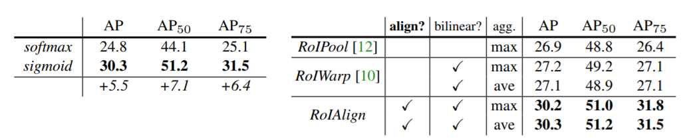
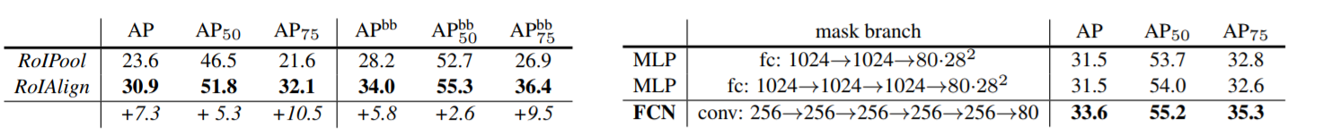
Results
Average Precision (AP)
[10] J. Dai, K. He, and J. Sun. Instance-aware semantic segmentation via multi-task network cascades. In CVPR, 2016.
[12] R. Girshick. Fast R-CNN. In ICCV, 2015
Per-pixel sigmoid and a binary loss is compared to a per-pixel softmax and a multinomial loss
The ResNet50-C4 backbone, with a stride of 16
RoIAlign with a ResNet-50-C5 backbone, with a stride of 32 pixels
Comparing multi-layer perceptrons (MLP)
and FCNs, using a ResNet-50-FPN backbone.

Slide 34
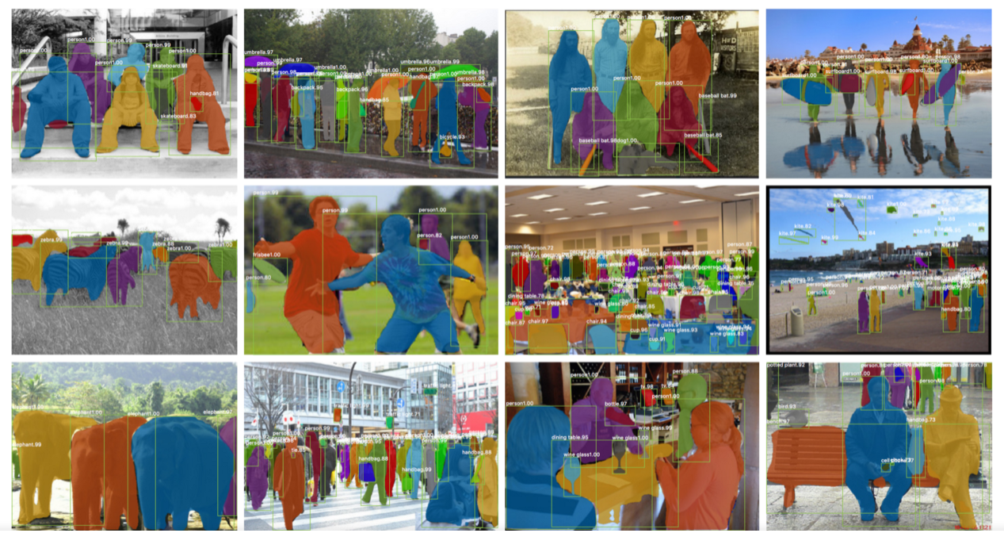
Results
Once these masks are generated, Mask R-CNN combines them with the classifications and bounding boxes from Faster R-CNN to generate such wonderfully precise segmentations

Slide 35
Mask R-CNN for Human Pose Estimation
The framework is extended for human pose estimation.
Model a key-point’s location using one hot mask.
Use Mask R-CNN to predict K masks.
K : key-points : (left shoulder, right elbow, knee joints etc.)
For each K key-point : training target → 1 hot binary m x m mask
Cross-entropy minimization → m² way softmax output.
As in instance segmentation the K key-points are treated independently

Slide 36
Mask R-CNN for Human Pose Estimation
Models are trained on all COCO trainval35k images that contain annotated key-points.
To reduce overfitting, as this training set is smaller, we train using image scales randomly sampled from [640, 800] pixels.
Trained for 90k iterations.
Initial learning rate = 0.02 and reducing it by 10 at 60k and 80k iterations.
Bounding-box NMS used with a threshold of 0.5.

Slide 37
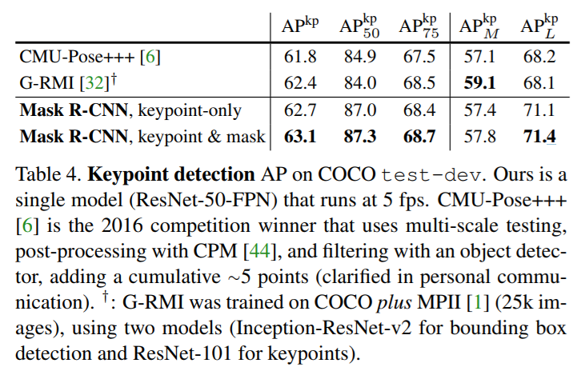
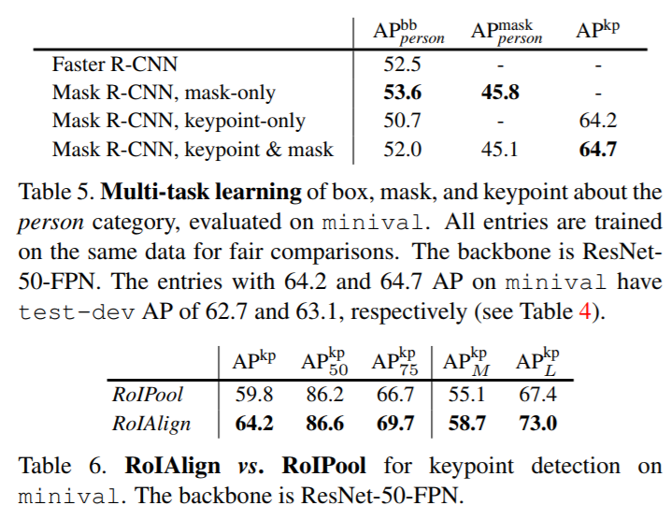
Results
Average Precision (AP)
[1] M. Andriluka, L. Pishchulin, P. Gehler, and B. Schiele. 2D human pose estimation: New benchmark and state of the art analysis. In CVPR, 2014.
[44] S.-E. Wei, V. Ramakrishna, T. Kanade, and Y. Sheikh. Convolutional pose machines. In CVPR, 2016.

Slide 38
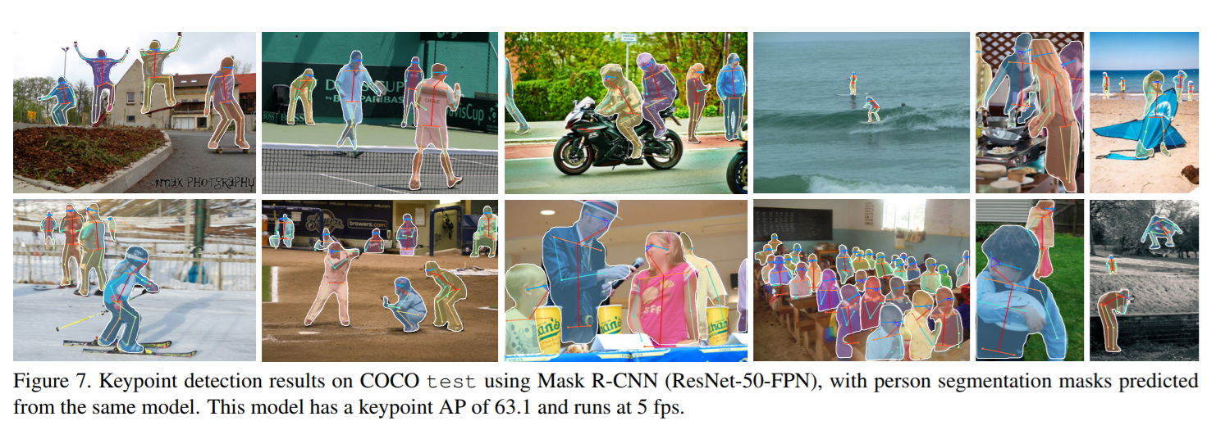
Results

Slide 39
Learning to segment everything! by Ronghang Hu et al.
This is a methodology used to improve Mask RCNN.
Existing methods for object instance segmentation require all training instances to be labeled with segmentation masks.
This requirement makes data annotation expensive.
This paper proposes a partially supervised training paradigm.
This paradigm makes training a Mask RCNN much less expensive, even on large datasets!
This allows us to train 3000 visual concepts in the Visual Genome dataset using box annotations and 80 categories in the COCO dataset having mask annotations.

Slide 40
Introduction
Object detectors have developed to obtain new capabilities like instance segmentation.
Typical instance segmentation models are restricted to ~100 object categories.
This is a small fraction to what we see in the visual world.
Limitation:
State-of-the-art instance segmentation models require strong supervision.
Limited / expensive for (adding) new object categories.
Possible to train high quality instance segmentation models without complete instance segmentation for all categories?

Slide 41
Introduction
Paper introduces:
Partially supervised instance segmentation.
A novel transfer learning method.
Benefits:
Build large scale instance segmentation models, exploiting both types of datasets
Scale state-of-the-art instance segmentation models to 1000s of categories!

Slide 42
Introduction
Transfer Learning
Built on Mask RCNN

Slide 43
Introduction
Weight transfer function
Learnt end to end.
Trained in Mask-RCNN using classes with mask annotations as supervision.

Slide 44
Introduction
Weight transfer function
Inference time: Predicts instance segmentation parameters of every category.

Slide 45
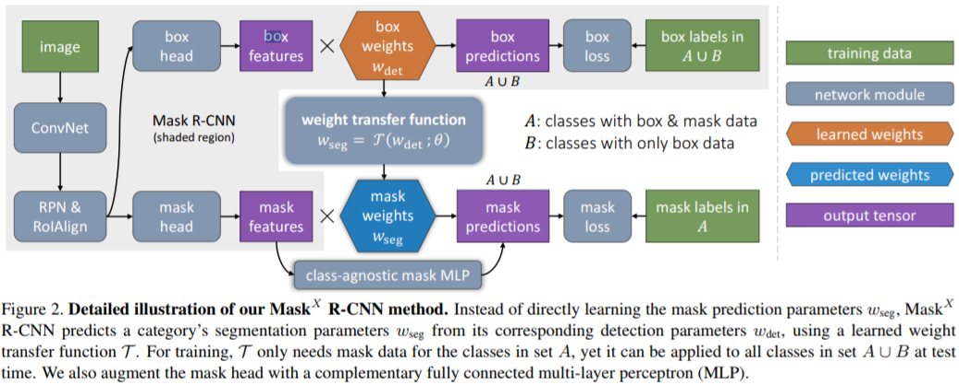
Learning to segment everything
C : Object categories

Slide 46
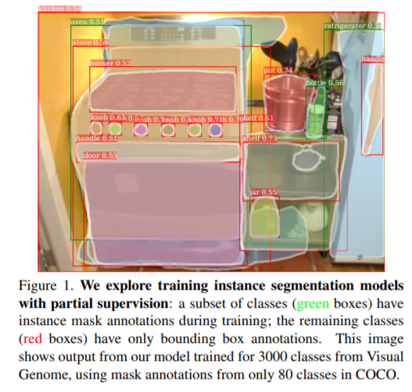
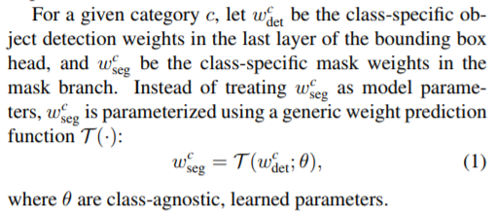
Learning to segment everything
C : Object categories
T (·) can be implemented as a small fully connected neural
network.

Slide 47
References
[1]: https://arxiv.org/pdf/1703.06870.pdf
[2]: https://arxiv.org/pdf/1506.01497.pdf
[3]: https://arxiv.org/pdf/1504.08083.pdf
[4]: https://arxiv.org/pdf/1311.2524.pdf
[5]: https://arxiv.org/pdf/1605.06409.pdf
[6]: https://arxiv.org/pdf/1711.10370.pdf
[7]: https://cs.stackexchange.com/questions/51387/what-is-the-difference-between-object-detection-semantic-segmentation-and-local
[8]: https://blog.athelas.com/a-brief-history-of-cnns-in-image-segmentation-from-r-cnn-to-mask-r-cnn-34ea83205de4
[9]: https://towardsdatascience.com/deep-learning-for-object-detection-a-comprehensive-review-73930816d8d9

